Slide 1
Bringing Gen AI to life for
Lloyds Relationship Managers
March 2024

Slide 2
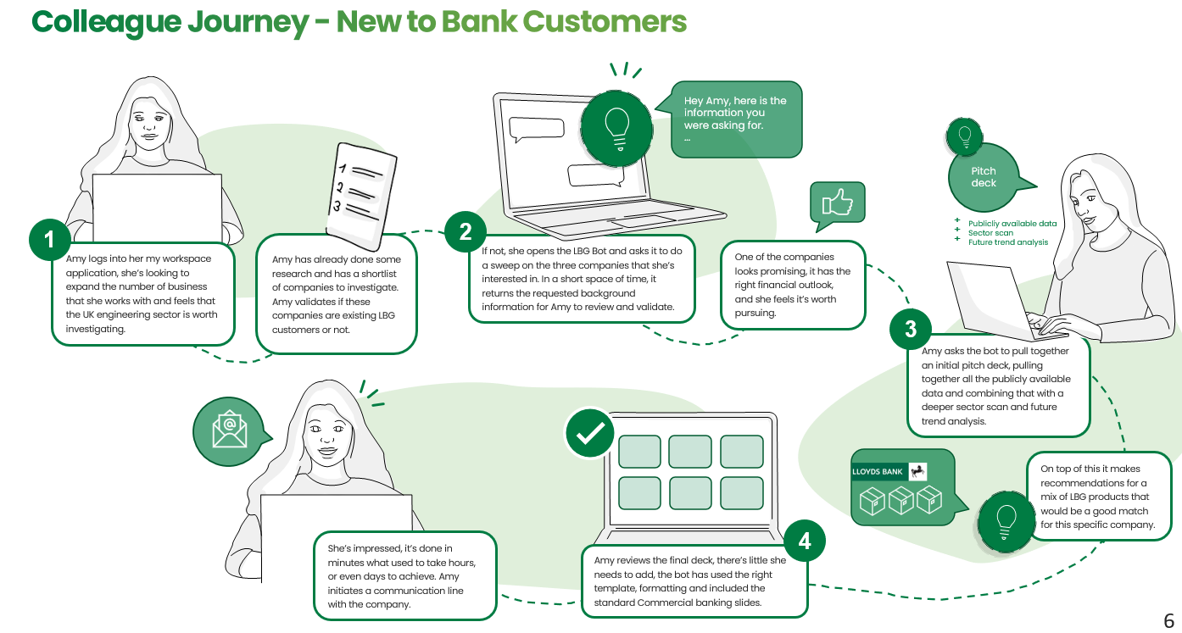
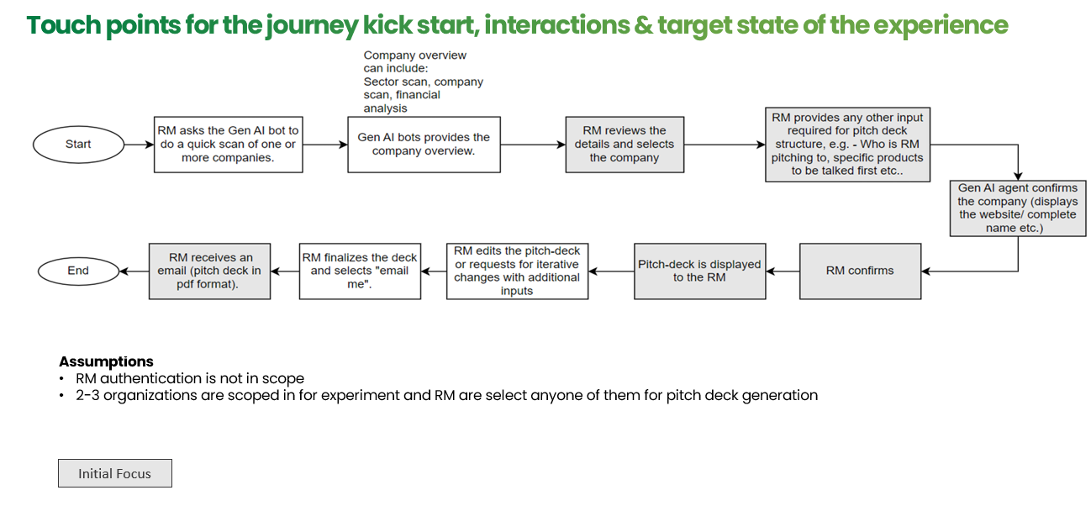
Gen AI Experiment - Lloyd’s RM Assistant
Link: http://35.204.203.165:3000/
Lloyds RM Assistant POC
Built for ‘Colleague Journey – New to Bank Customers’ journey
Deployed on LBG GCP environment for Colleague Testing & Feedback loops
The Pitch Pack template is aligned with RM. AI bot leverages it for rendering the output. It is configurable & scalable
POC Build
Data Ingestion model, few APIs developed for integration with the Gen AI models.
Google Storage leveraged for uploading documents (PDFs) for data ingestion
BHSF & SAGA were the initial two companies selected for data ingestion. Upon the awesome feedback received, we scaled the POC to 19 additional companies
3. Data Ingestion model
Reads data from Google Storage, extracts data, converts data into embeddings & stores it in Vector DB
Extracts data from Vector DB, Analyse & Answer relevant questions in the slides
4. Robust & scalable architecture with fast delivery timelines
Limitations in environment provisioned for POC: The ‘Preview’ slides generated have some formatting issues. However, the final pack generated do not have such issues

Slide 3
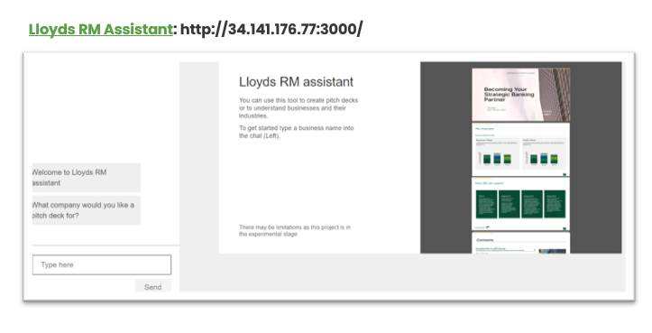
GenAI Experiments POC – Demo
Lloyd’s RM Assistant

Slide 4
How it’s built?

Slide 5
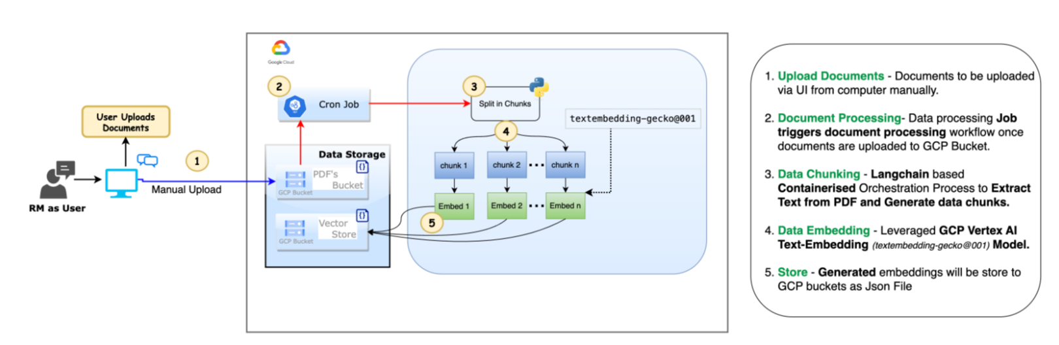
Architecture and Components
Notes:
Scalability –
Orchestration layer is containerized can be scaled as per he traffic, introduction of Caching mechanisms, rate limiting
GenAI services from cost perpective .. Scalability can be achieved by using opensources Modles, Vector DB etc and putting rtate linmiting on them ,

Slide 6
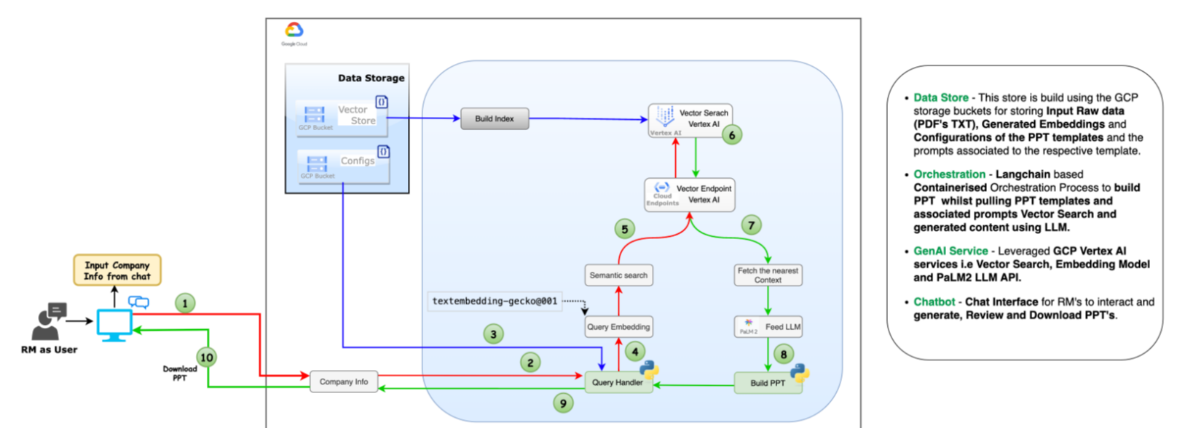
Architecture and Components
Notes:
Scalability –
Orchestration layer is containerized can be scaled as per he traffic, introduction of Caching mechanisms, rate limiting
GenAI services from cost perpective .. Scalability can be achieved by using opensources Modles, Vector DB etc and putting rtate linmiting on them ,

Slide 7
Our Plans for bringing to production
We scaled the POC from 2 companies to 19 & socialised it
There are discussions in progress within RM community to scale & take this to production

Slide 8
Thank You

